Slide 1
Upscaling Basic Sanitation for the Urban Poor (UBSUP)
Recap of DTF Introduction,
Site Selection &
Surveying

Slide 3
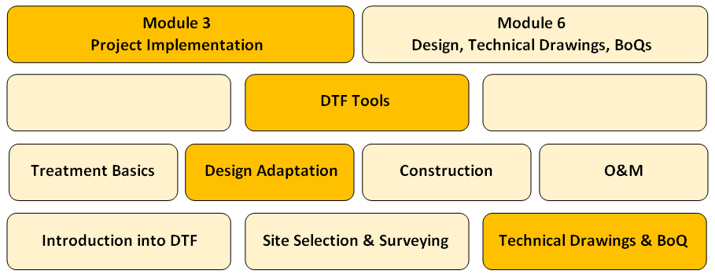
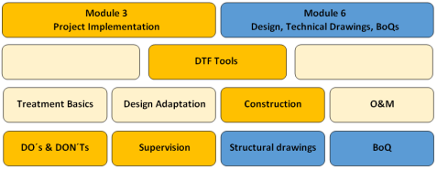
What is the overall context of this workshop
The SafiSan Toolkit
Training already provided (Day 1: Recap)
Days 1 – 3 (Adaptation)
Day 4 (Used for construction)
Days 1 – 3 (Used for construction)

Slide 4
What is the overall context of this workshop
The SafiSan Toolkit
Manual already provided
(+ various tools like DTF intro, site selection, decision matrix, templates for surveys, etc.)
Manual will be provided within the course of this training workshop
(+ various tools like AutoCAD drawings, BoQ in Excel, templates for contracting, supervision & monitoring

Slide 5
Content
Questions you might to ask yourself:
What is the context of this session?
Why do we need a DTF?
What is treated ... and why decentralised?
Where do we need a DTF?
How does a DTF work?
What needs to be considered during site selection?
Is there any support in selecting a site?

Slide 6
What is the context of this session?
The SafiSan Toolkit
Training will be provided in this week
Training to be provided
Training already provided (this session: Recap)

Slide 7
What is the context of this session?
The SafiSan Toolkit
All information can be found in your “Design Adaptation Manual”
Architectural and structural drawings as well as BoQ can be found on the WSTF website: SafiSan Toolkit – Module 6

Slide 8
Why do we need a DTF?
Close the sanitation value chain
Provide access to adequate sanitation for residents of Urban Low Income Areas (LIAs)
Reduce environmental pollution
Prevent public health hazards

Slide 9
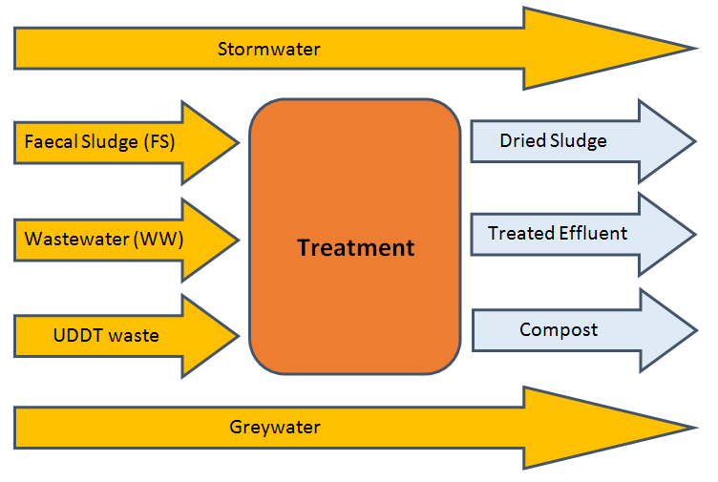
What is treated?
Various waste streams to be treated (or not):

Slide 10
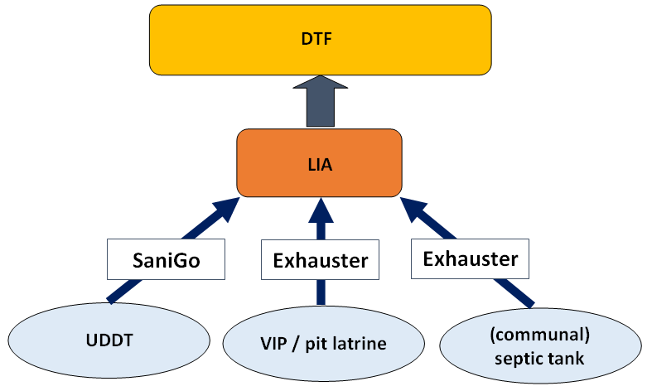
Where do we need a DTF?
Typical area of application for a DTF:

Slide 11
How does a DTF work: in general?
A DTF project follows several transport, treatment and reuse lines:
generation & pre-treatment
transport to the DTF
treatment in a DTF
reuse

Slide 12
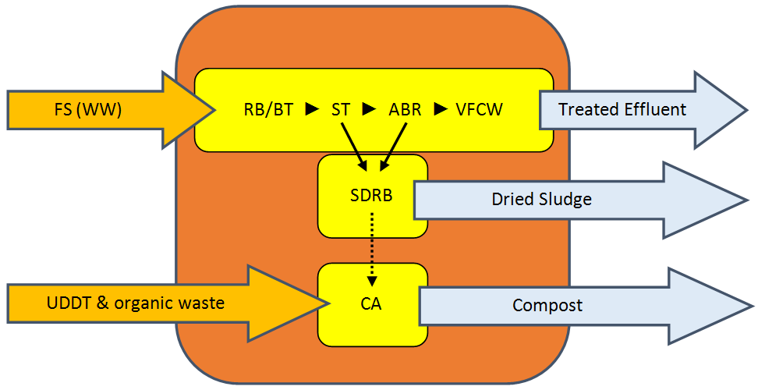
How does a DTF work?
A DTF consists of various parallel and sequenced treatment lines:

Slide 13
How does a DTF work?
RB/BT: Receiving Bay & Balancing Tank - mechanical preliminary treatment
ST: Settler - mechanical primary treatment
ABR: Anaerobic Baffled Reactor - anaerobic secondary treatment
VFCW: Vertical Flow Constructed Wetland - aerobic tertiary treatment
SDRB: Sludge Drying Reed Bed - parallel treatment of ST/ABR sludge
CA: Co-composting Area - parallel treatment of UDDT matter, organic waste (and dried sludge)

Slide 14
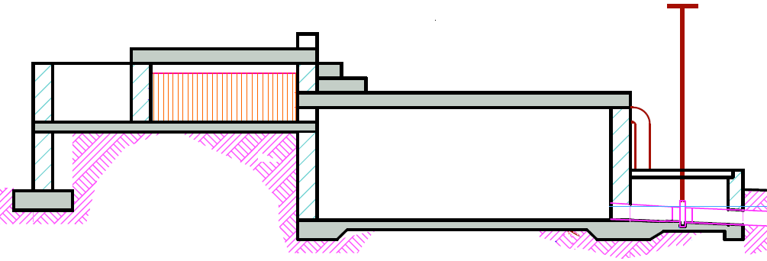
How does a RB/BT work?
Unload exhausters (2 at same time possible)
Screening of FS/WW to remove solid waste
Regulated discharge to the settler
Overflow to settler

Slide 15
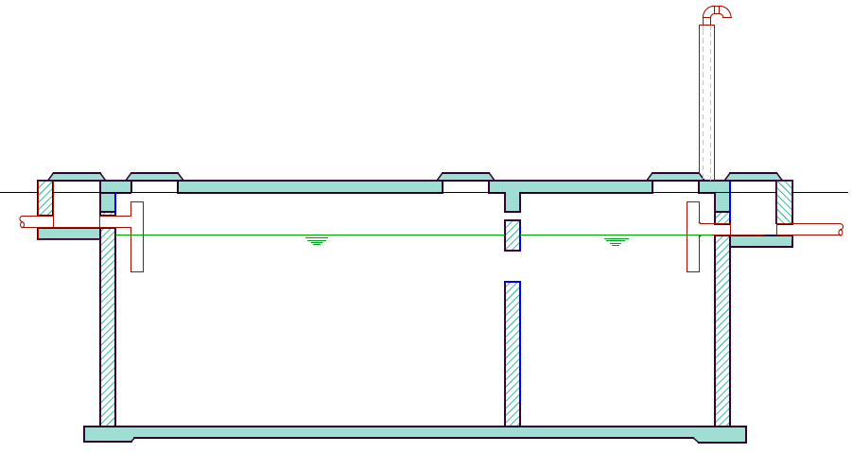
How does a ST work?
Mechanical treatment
Sedimentation and floatation of (mainly) inorganic solids
Scum removed from the surface
Sludge removed from the bottom
Treatment efficiency 25% - 40% removal of organic pollution
Pathogens and nutrients barely removed

Slide 16
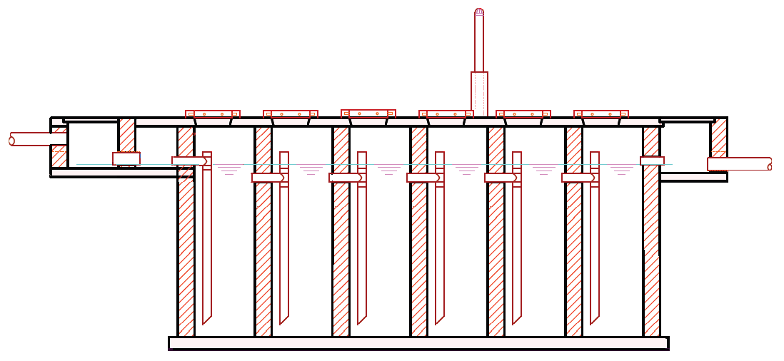
How does a ABR work?
6 chambers in sequence
Vertical pipes direct FS/WW from top to bottom
FS/WW passes through sludge whereby it is mixed with bacteria that decompose pollutants
Settled sludge is removed in regular intervals; some sludge must be left for continuous efficiency
Efficiency increases with higher organic load (65% - 95% BOD removal); pathogen reduction is 40-75%

Slide 17
How does a VFCW work?
Pre-treated FS/WW dosed intermittently on filter planted with reed
Roots grow into the filter media, bringing oxygen to the root zone
During a flush phase, water percolates down and is filtered by gravel
Nutrients and organic material are absorbed and degraded by bacteria attached to gravel and roots
Pathogens removed by natural die-off, predation by higher organisms, and sedimentation
A drainage network at the base collects the effluent

Slide 18
How does a SDRB work?
Filled with gravel to support the vegetation
Sludge applied to surface and filtrate collected in drain
Fresh sludge applied directly onto the previous layer (roots maintain the porosity of the filter media)
Various compartments charged alternating to allow for drying
Decreases sludge volume to 50% through decomposition and drying
Ideally coupled with co-composting area

Slide 19
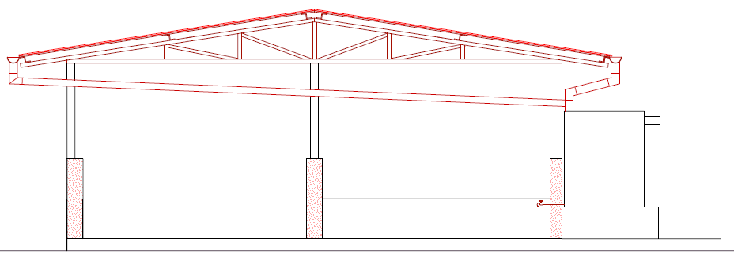
How does a CA work?
Dewatered sludge/UDDT matter mixed with organic waste 1:2-1:3
Mixed material piled into long heaps (windrows) and left to decompose for approx. 3 months
Windrows turned periodically to provide oxygen and ensure that all parts of the pile are subjected to the same heat treatment
Piles insulated with compost/soil to ensure even heat distribution
Careful planning and design required to avoid failure

Slide 20
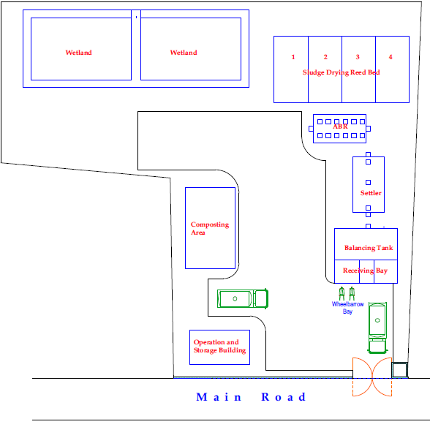
How does a DTF look like?

Slide 21
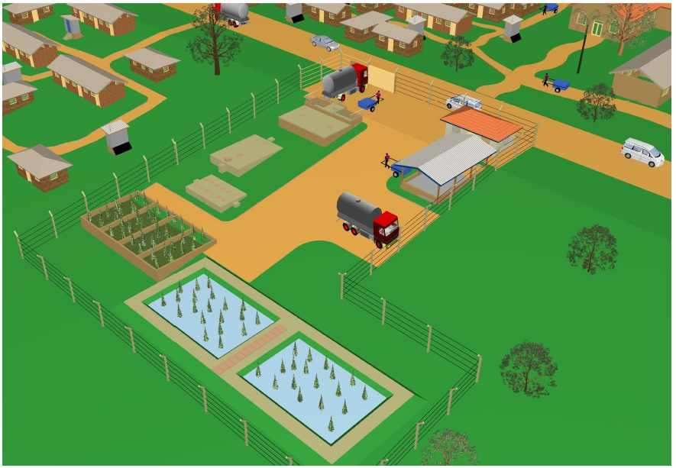
How does a DTF look like?

Slide 22
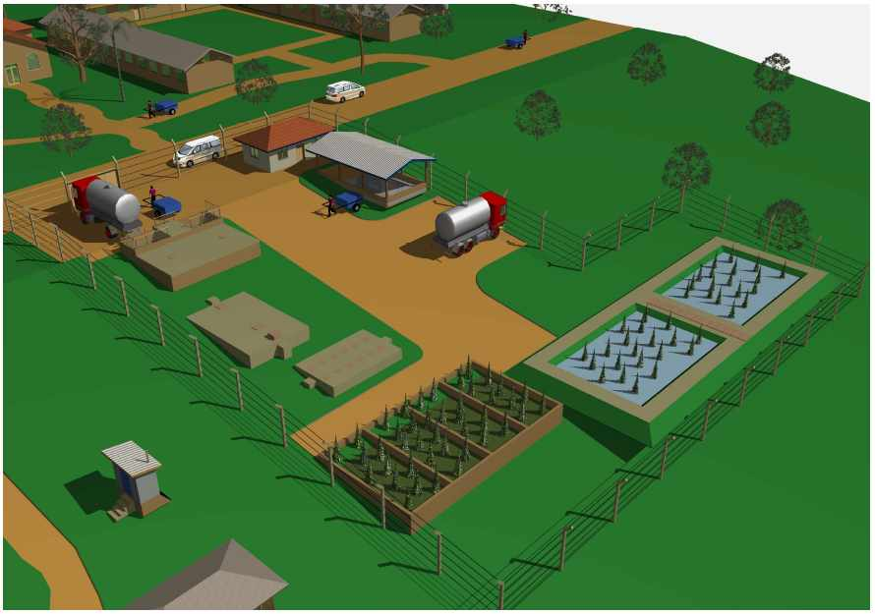
How does a DTF look like?

Slide 23
Who is responsible for site selection?
The site is selected by your DTF Technical Team
In collaboration with relevant stakeholders:
County Official
County Resident Monitor (CRM)
NEMA and WRMA
PHO
Chiefs, elders and residents
Supported by staff and “Flying Squad” of the WSTF (on request)

Slide 24
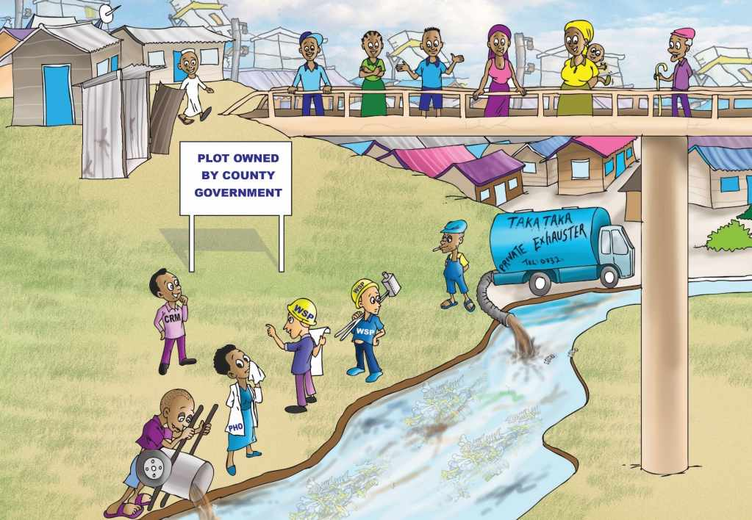
What needs to be considered?

Slide 25
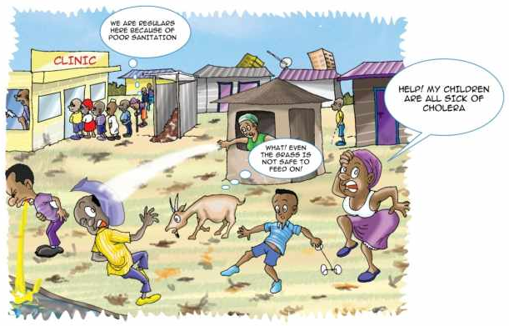
Will the DTF serve the target group?
DTFs primarily serve inhabitants of LIA
Higher income area can also benefit as long as focus is on LIA

Slide 26
Is the DTF required to treat excreta?
Investment and O&M costs only pay off if a minimum quantity of FS / UDDT matter is treated
WSP exhausters or private exhausters must discharge into the DTF, otherwise no FS treatment required (approx. 22m³/d)
SaniGo or other means of transport must discharge into the DTF, otherwise no CA required (approx. 250 UDDT)
Future demand needs to be assessed together with the County to ensure that demand does not decrease

Slide 27
Will the DTF “products” being used?
Clarify whether the treated effluent, dried sludge and compost is deposited / reused (► close the sanitation value chain)
If no reuse feasible, a more beneficial site should be considered
Even without reuse, site might be okay as main objective is to improve public health

Slide 28
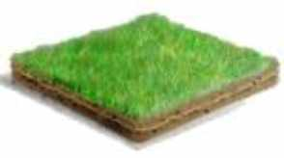
Is land available?
Assure proper land is available for construction and operations
Written permission by County, or
In case of private land, title deed in the name of your company
Required stakeholder must be involved during site selection and verification
Required approvals must be obtained in time

Slide 29
Is space available?
All required DTF modules must fit on the grounds
Different modules must be arranged in an operational manner
DTF module | Length [m] | Width [m] | Footprint [m²]
Receiving Bay / Balancing Tank (RB/BT) | 6 | 9 | 54
Settler (ST) | 8 | 4 | 32
Anaerobic Baffled Reactor (ABR) / BT | 11 | 4 | 44
Vertical Flow Constructed Wetland (VFCW) | 11 | 30 | 330
Sludge Drying Reed Bed (SDRB) | 19 | 11 | 209
Co-composting Area (CA) | 10 | 8 | 80
+ Space for an operator/storage building, (bypass) piping, inspection boxes, manoeuvring exhauster
► Total footprint about 1,000-1,500 m²; if only a CA is required, space requirement is 160 m².

Slide 30
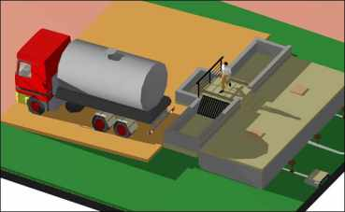
How can the DTF being reached?
DTF becomes uneconomic and useless if not accessible:
Distance for exhausters max. ~10km
Distance SaniGo or other transport means max. ~ 5km
Accessible by road
Slope appropriate for exhausters and manual means of transport

Slide 31
Which role play slope and levels?
DTF module | Difference [m] | Remark
ST | 0.10 | Between inlet and outlet pipe
ABR | 0.15 | Between inlet and outlet pipe
Siphon/BT | 0.85 | Between ABR outlet and outlet of BT attached to ABR (for intermittent loading of VFCW)
VFCW | 0.70 | Between feeding and drainage pipe
Within treatment modules: 1.80m
Within network: ~ 0.7m based on 1% slope (for 6m between modules, 50m to river)
Total level difference: ~ 2.5m (equivalent ~ 2% slope)
► Required level differences reduce with distance between modules
► Levels of all treatment modules depend on level of final effluent discharge point (e.g. flooding level of river)
Receiving Bay
Δh
River

Slide 32
What is the final effluent discharge point?
Discharge points refers to effluent of VFCW
► Nearby River (flooding level) - preferred
► Existing drainage channel / trench
Should be max. 100m from VFCW outlet
Inspection chambers to be placed every 20-25m for cleaning

Slide 33
Which role plays solid waste?
Well sorted organic waste is required for co-composting:
Bio-waste to be mixed 2:1 - 3:1 with UDDT matter in the CA
Collected from LIA or markets
Transported by SaniGo or existing solid waste collectors

Slide 34
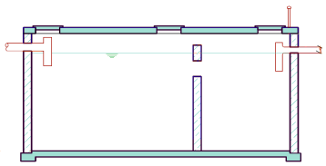
Which role play soil conditions?
Soil conditions play a role during construction and related costing
Excavation; i.e. Settler (ST) and Anaerobic Baffled Reactor (ABR)
Soft soil ↔ hard rock
Assessment required to establish costs in BoQ / tender evaluation

Slide 35
Who will build the DTF?
Your WSP needs to outsource construction to a contractor
Construction quality is crucial to guarantee proper operations
Reliable and capable contractor required
Trained artisans, technically qualified staff
Required equipment (e.g. concrete mixer, form works, dumpy level)
Proven experience in comparable projects
References and reputation
Rigorous/permanent supervision by WSP is required

Slide 36
Is the DTF affordable?
Affordable: Revenues > Expenses:
Expenses:
O&M cost: operator, preventative / corrective maintenance, repairs
Incentive for Sanitation Teams to dispose of UDDT matter
Revenues:
Cost saving for unloading WSP exhausters
Fee charged from private exhauster services (► law enforcement)
Tariff increase approved by WASREB for improved service delivery
Sales of compost and soil conditioner

Slide 37
Is there any support in selecting a site?
Decision matrix...
Is a site generally feasible
Which treatment trains are required
Tool for baseline data collection and field survey
Stakeholder analysis to explain roles and responsibilities of relevant actors
Workflow chart to showcase which steps need to be taken and which stakeholder are to be involved at what point

Slide 38
Decision matrix
Two questionnaires support to find out:
Matrix 1: Is a site generally suitable?
Matrix 2: Which treatment trains are required:
Treatment of UDDT dried matter (approx. 250 UDDTs)
Treatment of FS (approx. 22m³/d)

Slide 39
How is matrix 1 filled out?
Colum No: Reference number of guiding question
Column Guiding Question: Questions referring to considerations
Column Yes / No / I don’t know / N/A: Fill in answer on guiding question
Column Comments: Add any clarification you think is required
Columns 4-6 are filled by WSTF staff – not by WSP

Slide 40
How is matrix 2 filled out?
Colum No: Reference number of guiding question
Column Guiding Question: Questions referring to considerations
Column Yes / No / I don’t know: Fill in answer on guiding question
Column Comments: Add any clarification you think is required
Grey colored cells are not to be answered
Columns 5-7 are filled by WSTF staff – not by WSP

Slide 41
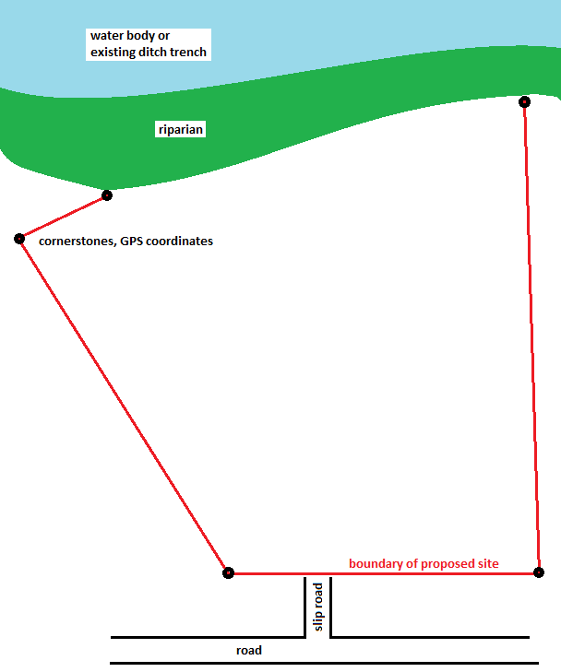
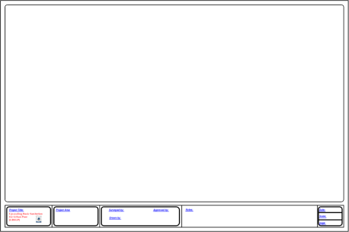
Baseline data collection - Boundaries
Mark corners (e.g. with metal rods)
Take preferably GPS coordinates of cornerstones
Note distances on the layout drawing
Ensure sufficient distance (riparian) to water bodies as per NEMA

Slide 42
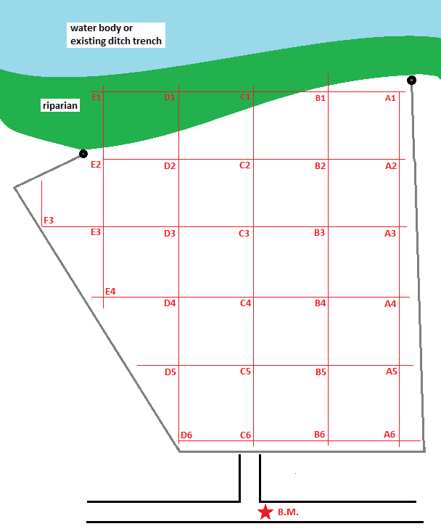
Baseline data collection - Raster levelling
Define a fix and suitable benchmark
Mark location of BM on layout drawing and permanently at site
Take levels according to a fix raster (20-30 points)
Note levels at provided template
Reference Point | Level (m)
B.M. | 0.000
A1
A2
A3
...
...

Slide 43
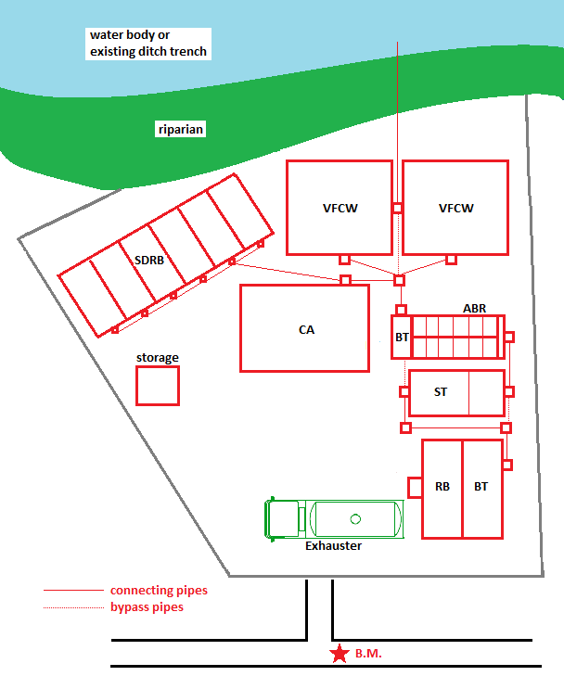
Baseline data collection - Arrangement
Draw modules on a new layout plan
Consider space for manoeuvring of exhauster trucks
Ensure proper arrangement of pipes, bypass pipes and inspection boxes
Consider slopes / topography

Slide 44
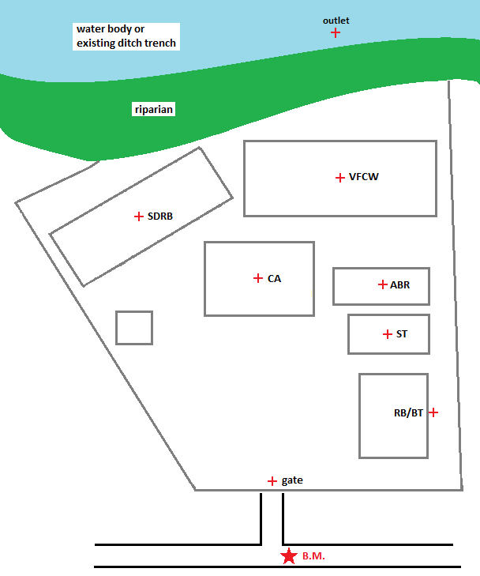
Baseline data collection - Levelling
Take levels at the following locations
Level of the final effluent discharge point (flooding level)
Ground levels where RB, treatment modules and gate will be located
Note levels in table template
Reference Point | Level (m)
B.M. | 0.000
Outlet
VFCW
CA
ABR
...

Slide 45
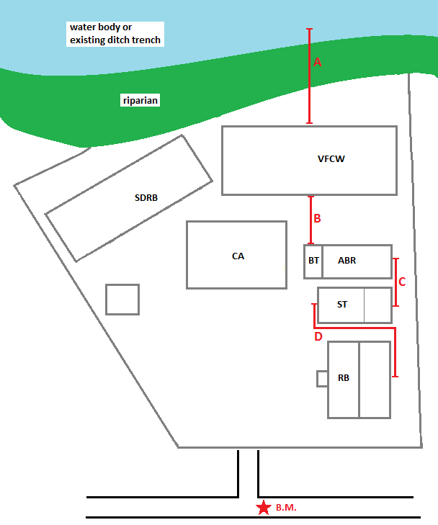
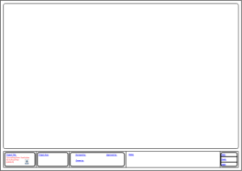
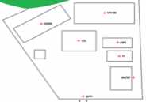
Baseline data collection - Distances
Take distances between the treatment modules that are arranged in series:
VFCW outlet to final discharge point
Outlet of ABR-BT to VFCW
ST outlet to ABR inlet
Outlet of RB/BT to ST inlet
Note distances on layout plan and in table
Reference | Distance (m)
A
B
C
D

Slide 46
Baseline data collection - Soil conditions
Establish soil conditions at all locations where excavation is required
Particularly for ST and ABR (underground)
Note levels in table template
Reference Point | Soil conditions
RB/BT
ST
ABR
VFCW
SDRB
CA
House

Slide 47
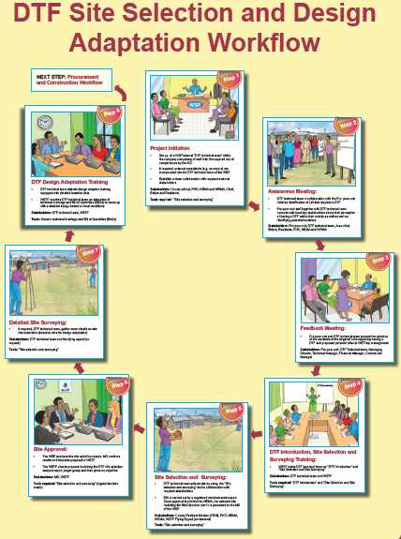
Workflow & stakeholders

Slide 48
What are the results of your site selection?
Next session: Presentation and discussion of DTF concepts and sites
Short summary/presentation of both decision matrices
Site layouts incl. entrance and discharge point, arrangement of modules, distances and level differences between relevant spots
Expected problems
Waste collection and reuse concept

Slide 49
Do you have any questions, remarks or suggestions?

